Slide 1
Active objects:
programming and composing safely large-scale distributed applications
Ludovic Henrio SCALE team, CNRS – Sophia Antipolis
July 2014 – Middlesex University, London

Slide 2
About the SCALE team
Distributed applications are:
Difficult to program safely (correctness)
Difficult to program and run efficiently (efficient deployment running and synchronisation)
In the scale team we propose:
Languages: active object, asynchronous processes
Design support: Vercors – specification and verification of distributed components
Runtime support: a Java middleware, and VM placement algorithms
Application domains: cloud computing, service oriented computing …

Slide 3
My objective
Help the programmer write correct distributed applications and run them safely.
By designing languages and middlewares
By proving their properties
By providing tools to support the development and proof of correct programs
Notes:
What is a middleware?

Slide 4
Agenda
Introduction: Active Objects Different models, strengths and weaknesses
Multi-active Objects
Software components from active objects
About formal methods

Slide 5
How to program distributed systems?
By programming different entities
Each entity should be independent from the others:
from a data point of view: data distribution
from an execution point of view: decoupled entities, asynchronous interactions
Different similar paradigms:
actors, active objects, reactive programming, service oriented programming

Slide 6
Active objects: generalities
Asynchronous method calls / requests
No race condition: each object manipulated by a single thread
α
β
f
Result
Result
foo.getval( )
foo.getval( )
foo = beta.bar(p)
foo.getval( )
WBN!!
Caromel, D., Henrio, L.: A Theory of Distributed Object. Springer-Verlag (2005)

Slide 7
ASP/ProActive Principles
Active and Passive objects
Request queue (FIFO)
Implicit transparent futures
Only two kinds of shared references: Active objects and Futures
α
β
A beta = newActive (“A”, …);
V result = beta.foo(b);
…..
result.getval( );
beta.foo(b)
foo
Request invocation

Slide 8
ASP/ProActive Principles
Active and Passive objects
Request queue (FIFO)
Implicit transparent futures
Only two kinds of shared references: Active objects and Futures
α
β
f
beta.foo(b)
foo
result
Request invocation
result=beta.foo(b)

Slide 9

First Class Futures
α
β
f
delta.snd(result)
δ

Slide 10
First Class Futures
α
β
Active objects are the unit of distribution and concurrency (one thread per AO / no data shared)
ProActive is a Java library ASP is a “calculus”
delta.snd(result)
δ

Slide 11
ASP Limitations
AO1
AO2
No data sharing – inefficient local parallelism
Parameters of method calls/returned values are passed by value (copied)
No data race-condition simpler programming + easy distribution
Risks of deadlocks, e.g. no re-entrant calls
Active object are single threaded
Re-entrance: Active object deadlocks by waiting on itself (except if first-class futures)
Solution: Modifications to the application logic difficult to program
Notes:
No data sharing
* active object location transparent – must pass by value
* even if deploying several AO on a multi-core, still data copy overhead
No re-entrant calls
* deadlocking because of single-threaded nature
* must rewrite application (at least tail recursive)

Slide 12
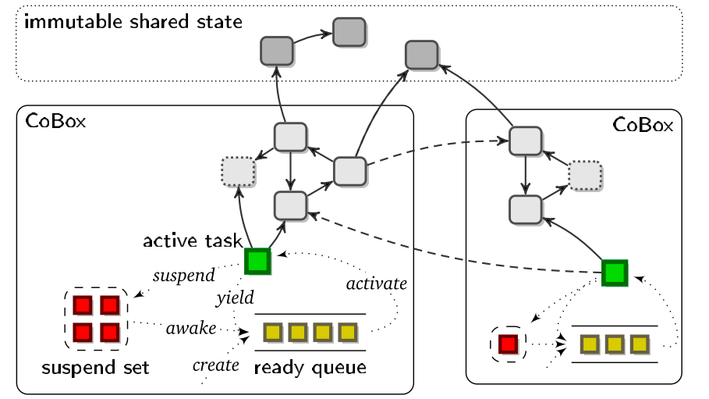
Other active object models: Cooperative multithreading
Creol, ABS, and Jcobox:
Active objects & futures
Cooperative multithreading
All requests served at the same time
But only one thread active at a time
Explicit release points in the code
can solve the re-entrance problem
More difficult to program: less transparency
Possible interleaving still has to be studied

Slide 13
Other approaches
Actors (~1985) vs. Active objects
Functional vs. OO programming -> sending messages vs. Remote method invocation
Actors do not use futures (callbacks) -> more difficult to program but no deadlock
Instead of using state variables actor can change the way they react to incoming message (become)
JAC (Java annotations for concurrency)
Declarative parallelization in Java
Expressive (complex) set of annotations
Multithreaded AOs:
A simple version of JAC for simple active objects à la ASP ➔ multi-active objects
efficient and easy to program

Slide 14
Agenda
Introduction: Active Objects
Multi-active Objects
Software components from active objects
About formal methods

Slide 15
Multi-active objects (with Fabrice Huet and Zsolt Istvan)
A programming model that mixes local parallelism and distribution with high-level programming constructs
Execute several requests in parallel but in a controlled manner
join()
Provided add, add and monitor are compatible
add() {
…
}
add() {
…
… }
monitor(){…
… }
Note: monitor is compatible with join

Slide 16


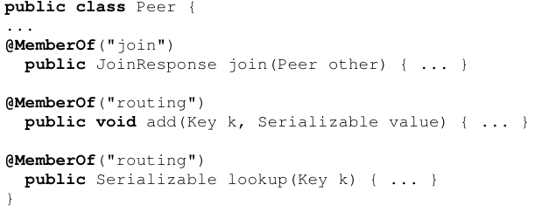
Declarative concurrency by annotating request methods
Groups
(Collection of related methods)
Rules
(Compatibility relationships between groups)
Memberships
(To which group each method belongs)
Notes:
Pairwise relation tedious if many methods.
Inheritance very problematic.

Slide 17
Dynamic compatibility: Principle
Compatibility may depend on object’s state or method parameters
join()
Provided the parameters of add are different
(for example)
add(int n) {
…
}
add(int n) {
…
… }

Slide 18

Dynamic compatibility: annotations
Define a common parameter for methods in a group
a comparison function between parameters (+local state) to decide compatibility
Returns true if requests compatible

Slide 19
Scheduling Requests
An « optimal » request policy that « maximizes parallelism »:
Schedule a new request as soon as possible (when it is compatible with all the served ones)
Serve it in parallel with the others
Serves
Either the first request
Or the second if it is compatible with the first one (and the served ones)
Or the third one …
Compatibility =
requests can execute at the same time
and can be re-ordered
compatible

Slide 20
More efficiency: Thread management
Too many threads can be harmful:
memory consumption,
too much concurrency wrt number of cores
Possibility to limit the number of threads
Hard limit: strict limit on the number of threads
Soft limit: prevents deadlocks Limit the number of threads that are not in a WBN
@DefineThreadConfig(threadPoolSize=1, hardLimit=false)
current
thread
(1)
other
thread
V v = o.bar(); (1)
v.foo(); (2)
(2)

Slide 21
Prioritizing waiting (compatible) requests
@DefinePriorities ({
@PriorityOrder({
@Set(groupNames = {"G1"}),
@Set(groupNames = {"G2"}),
@Set(groupNames = {"G5","G4"})
}),
@PriorityOrder({
@Set(groupNames = {"G3"}),
@Set(groupNames = {"G2"})
})
})
G1
dependency
G3
dependency
G2
G5
G4
Low priority
incoming
request R2
Priorities are automatically taken into account in the scheduling policy
R4 R3 R1

Slide 22
Hypotheses and programming methodology
We trust the programmer: annotations supposed correct
static analysis or dynamic checks should be applied in the future
Without annotations, a multi-active object runs like an active object
If more parallelism is required:
Add annotations for non-conflicting methods
Declare dynamic compatibility
Protect some memory access (e.g. by locks) and add new annotations
Easy to program
Difficult to program
More parallelism ➔ More complex code / better performance

Slide 23
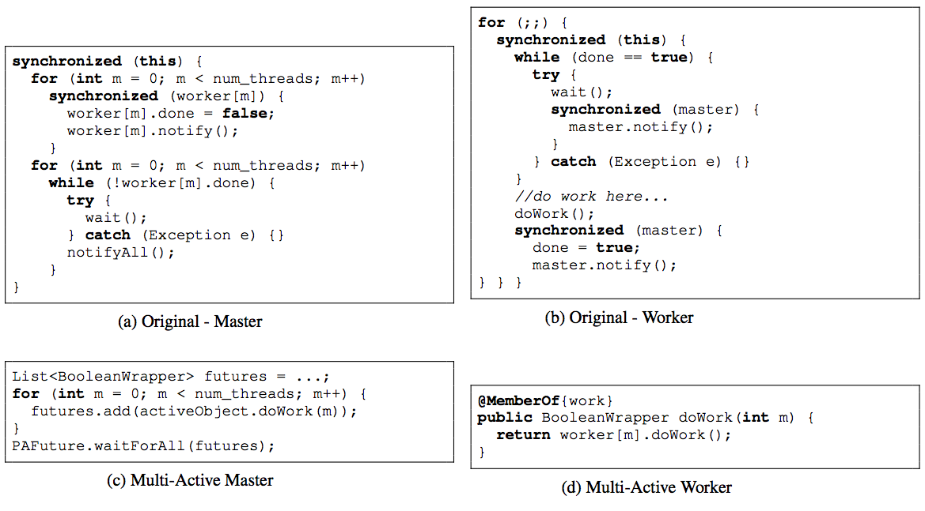
Expriment #1: NPB Multi-active objects are simpler to program
Original vs. Multi-active object master/slave pattern for NAS
Performance is similar (MAO are a few % slower)

Slide 24
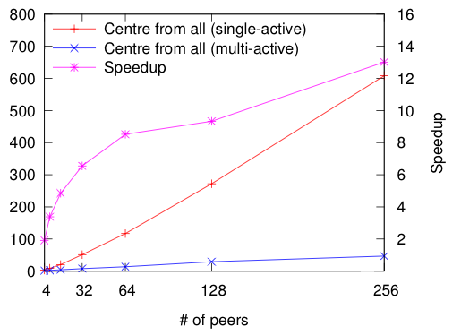
Experiment #2: CAN MAOs run faster
Each peer is implemented by a (multi) active object and placed on a machine
Parallel and distributed
Parallel routing
Significant speedup due to parallelisation of communications, while controlling which communications are performed in parallel … With only a few annotations !

Slide 25
Agenda
Introduction: Active Objects
Multi-active Objects
Software components from active objects
About formal methods

Slide 26
What is a component? / Why components?
Piece of code (+data) encapsulated with well defined interfaces [Szyperski 2002]
Very interesting for reasoning on programs (and for formal methods) because:
components encapsulate isolated code ➔ compositional approach (verification, …)
interaction (only) through interfaces ➔ well identified interaction ➔ easy and safe composition
➔ Reasoning and programming is easier and compositional

Slide 27
What are Components?
Primitive component
Business code
Client / output
Server / input

Slide 28

What are Components?
Composite component
Primitive component
Primitive component
Business code
Business code
Grid Component Model (GCM)
An extension of Fractal for Distributed computing
GCM: A Grid Extension to Fractal for Autonomous Distributed Components - F. Baude, D. Caromel, C. Dalmasso, M. Danelutto, V. Getov, L. Henrio, C. Pérez - Annals of Telecom. - 2008

Slide 29
GCM: “Asynchronous” Fractal Components
Add distribution to Fractal components
Many-to-many communications
ProActive/GCM implemented in the GridCOMP European project, basedon active objects:
No shared memory between components
Components evolve asynchronously
Components communicate by request/replies (Futures)

Slide 30
Discussion: what is a Good size for a (primitive) Component?
Not a strict requirement, but somehow imposed by the model design
According to CCA or SCA, a service (a component contains a provided business function)
According to Fractal, a few objects
According to GCM, a process
In GCM/ProActive,
1 Component (data/code unit)
= 1 Active object (1 thread = unit of concurrency) = 1 Location (unit of distribution)

Slide 31
A Primitive GCM Component
CI
CI.foo(p)
Primitive components communicate by asynchronous requests on interfaces
Components abstract away distribution and concurrency
In ProActive/GCM a primitive component is an active object
Notes:
----- Notes de la réunion (7/16/12 11:21) -----
enlever requete1
1

Slide 32
Futures for Components
1
2
f=CI.foo(p) ……….
3
g=f+3
g=f+3
Component are independent entities
(threads are isolated in a component)
+
Asynchronous requests with results
⬇
Futures are necessary
Notes:
Ajouter 1 2 3

Slide 33
First-class Futures and Hierarchy
return C1.foo(x)
… … …
Without first-class futures, one thread is systematically blocked in the composite component.
A lot of blocked threads
Without mulit-active objects ➔ systematic deadlock

Slide 34
Collective interfaces
One-to-many = multicast
Many-to-one = gathercast
Distribution and synchronisation/collection policies for invocation and results
Composite component
Primitive component
Primitive component
Business code
Business code
Primitive component
Business code
Primitive component
Business code

Slide 35

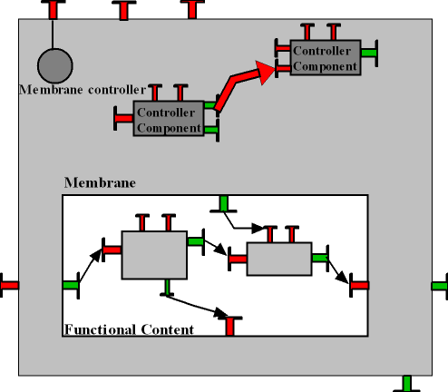
Adaptation in the GCM
Functional adaptation: adapt the architecture + behaviour of the application to new requirements/objectives/environment
Non-functional adaptation(with Paul Naoumenko): adapt the architecture of the container+middleware to changing environment/NF requirements (QoS …)
Additional support for reconfiguration (with Marcela Rivera):
A stopping algorithm for GCM components
A Scripting language for reconfiguring distributed components
Both functional and non-functional adaptation are expressed as reconfigurations
Language support for distributed reconfiguration: GCM-script
A platform for designing and running autonomic components
(with Cristian Ruz)
Programming distributed and adaptable autonomous components—the GCM/ProActive framework Françoise Baude, Ludovic Henrio, and Cristian Ruz Software: Practice and Experience - 2014
A Component Platform for Experimenting with Autonomic Composition Françoise Baude, Ludovic Henrio, and Paul Naoumenko. Autonomics 2007.

Slide 36
Agenda
Introduction: Active Objects
Multi-active Objects
Software components from active objects
About formal methods

Slide 37
What are Formal Methods (here)?
Mathematical techniques for developping computer-based systems:
Programs
Languages
Systems
What tools?
Pen and paper (PP)
Theorem proving (TP) = proof assistant
Model checking (MC) = check a formula on (an abstraction of) all possible executions
Static analysis
…

Slide 38
My general approach
Implementation
Programmingmodel and definitions
Correctness
& Optimizations
Generic
properties
Verification and tools
Correctness
& Optimizations
Increase the confidence people have in the system
Help my colleagues implement correct (and efficient) middlewares
Help the programmer write, compose, and run correct and efficient distributed programs
Notes:
----- Notes de la réunion (7/16/12 11:21) -----
animer rouge et jaune

Slide 39
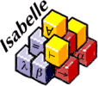
A Framework for Reasoning on Components
Generic
properties
Formalise GCM in a theorem prover (Isabelle/HOL ) Component hierarchical Structure
Bindings, etc…
Design Choices
Suitable abstraction level
Suitable representation (List / Finite Set, etc …)
Basic lemmas on component structure
Composite component
Primitive component
Business code
Primitive component
Business code

Slide 40
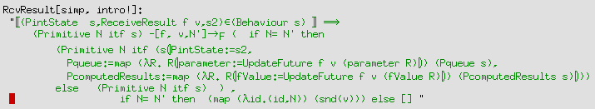
A semantics of Primitive Components
Primitive components are defined by interfaces plus an internal behaviour, they can:
emit requests
serve requests
send results
receive results (at any time)
do internal actions
some rules define a
correct behaviour,
e.g. one can only send result for a served request

Slide 41
A refined GCM model in Isabelle/HOL
More precise than GCM, give a semantics to the model:
asynchronous communications: future / requests
request queues
no shared memory between components
notion of request service
More abstract than ProActive/GCM
can be multithreaded
no active object, not particularly object-oriented
A guide for implementing and proving properties of component middlewares
“certified” by a theorem prover
Similarities with: SCA and Fractal (structure), Creol (futures)

Slide 42


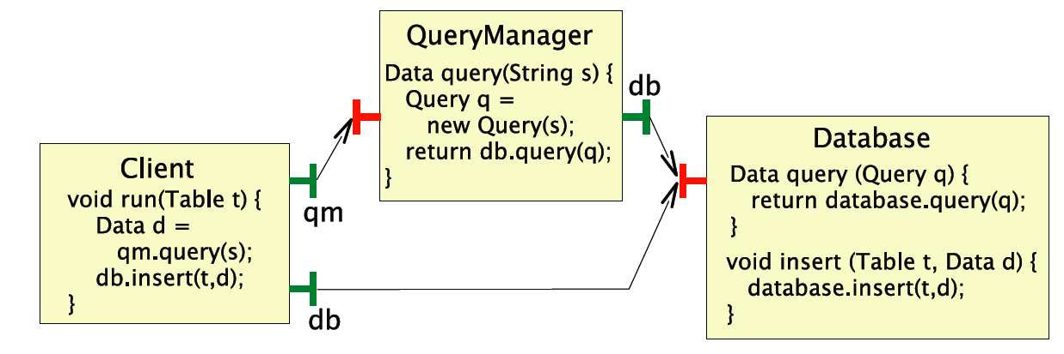
Motivating example: What Can Create Deadlocks in ProActive/GCM?
Verification and tools
A race condition:
Detecting deadlocks can be difficult ➔ behavioural specification and verification techniques

Slide 43
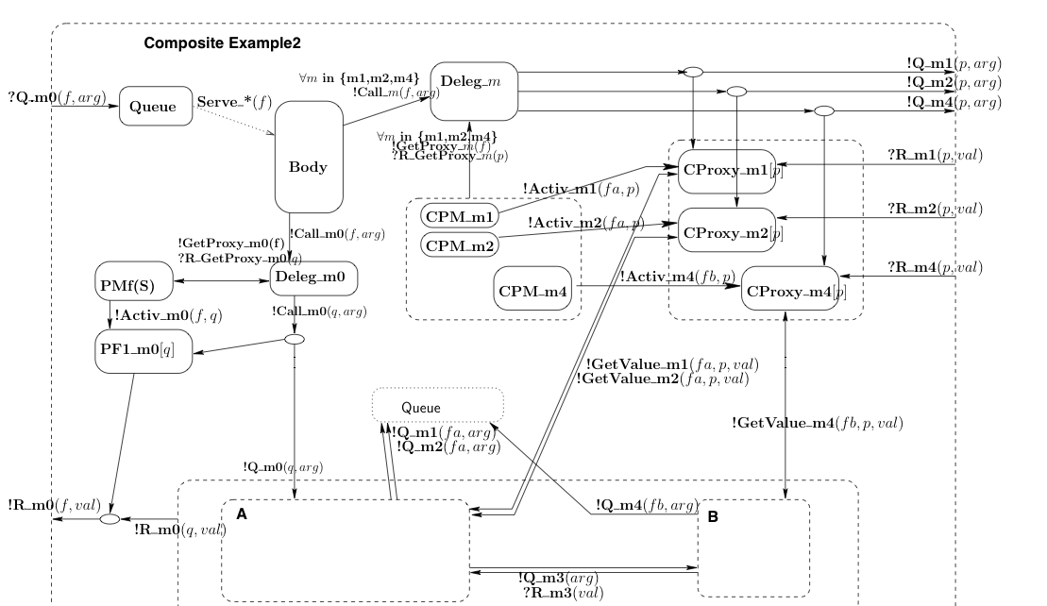
How to ensure the correct behaviour of a given program?
Theorem proving too complicated for the ProActive programmer
Our approach: behavioural specification
Service methods
Service methods
pNets:
Trust the implementation step
Or static analysis
Generate correct (skeletons of) components (+static and/or runtime checks)
Behavioural Models for Distributed Fractal Components Antonio Cansado, Ludovic Henrio, and Eric Madelaine - Annals of Telecommunications - 2008

Slide 44
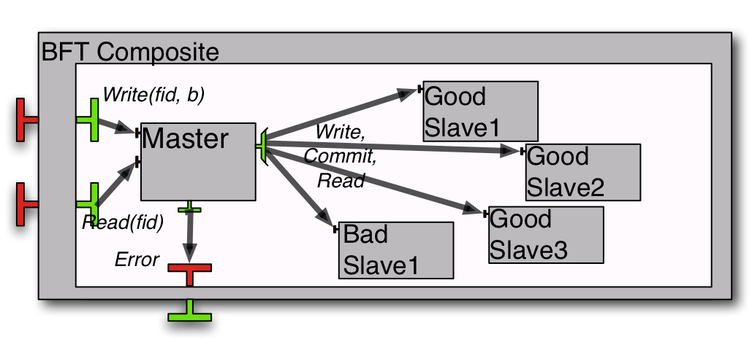
Use-case: Fault-tolerant storage
1 multicast interface sending write/read/commit requests to all slaves.
the slaves reply asynchronously, the master only needs enough coherent answers to terminate
Verifying Safety of Fault-Tolerant Distributed Components Rabéa Ameur-Boulifa, Raluca Halalai, Ludovic Henrio, and Eric Madelaine - FACS 2011

Slide 45
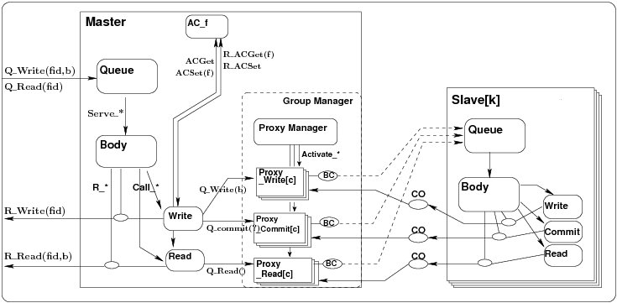
Full picture: a pNet
Support for parameterised families
?Q_Write(x)
!Q_Write(b)
Synchronisation vectors

Slide 46
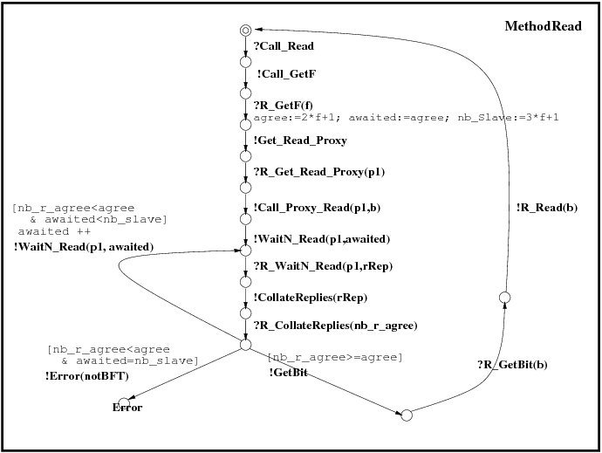
Basic pNets: parameterized LTS
Labelled transition systems, with:
Value passing
Local variables
Guards….
Can be written as a UML diagram
Eric MADELAINE

Slide 47
Properties proved
Reachability:
1- The Read service can terminate
 fid:nat among {0...2}. ∃ b:bool. <true* . {!R_Read !fid !b}> true
2- Is the BFT hypothesis respected by the model ?
< true* . 'Error (NotBFT)'> true
Inevitability:
After receiving a Q_Write(f,x) request, it is (fairly) inevitable that the Write services terminates with a R_Write(f) answer, or an Error is raised.
Functional correctness:
After receiving a ?Q_Write(f1,x), and before the next ?Q_Write, a ?Q_Read requests raises a !R_Read(y) response, with y=x
(written in mu-calculus or Model Checking Language (MCL), Mateescu et al, FM’08)
Prove
generic properties like absence of deadlock
or properties specific to the application logic

Slide 48
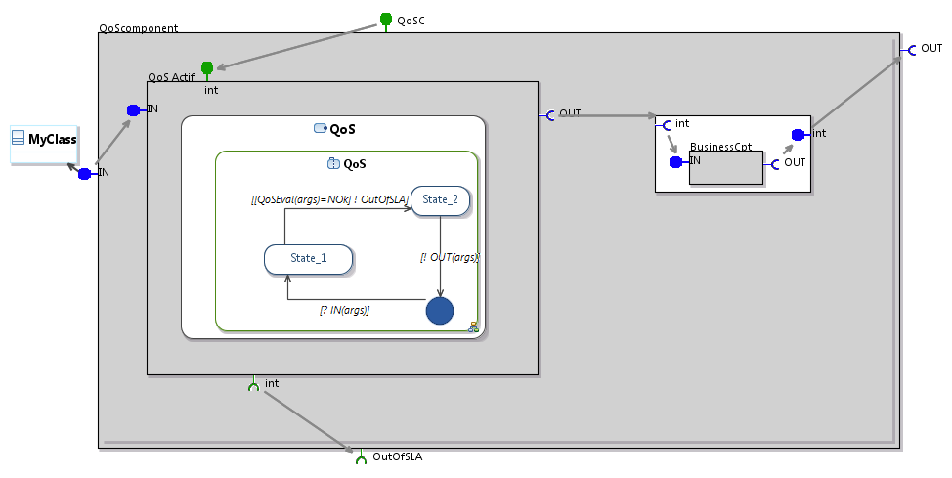
Modelling architecture + behaviour
Modelling platform: An environment for designing and proving correctness of GCM/ProActive components
Based on the Obeo Designer platform (Eclipse)
Challenge: integrate Fractal/GCM DSL with UML diagrams
Executable code and behavioural model generation

Slide 49
CONCLUSION AND CURRENT WORKS

Slide 50
Conclusion (1/2)
Active object programming model
Programming of distributed application is easy
Multi-active objects, a new programming model:
Local concurrency and efficiency on multi-cores
Transparent multi-threading
Simple annotations
A programming model for locally concurrent and globally distributed objects

Slide 51
Conclusion (2/2)
(Multi)active objects are very convenient for implementing services and components
Active objects unify the notions of: thread(s), service, unit of distribution
Formal methods should help writing correct programs
Our approach: generic properties + behavioural verification of programs

Slide 52
Next steps / hot topics
Have a complete tool chain for the design and verification of distributed components (Vercors)
Formally specify and reason on multi-active objects:
Semantics specified
Formalisation in Isabelle/HOL with Florian Kammueller
Behavioural specification [TODO] …
Implementation and support for Multi-active objects (with Justine Rochas)
An ABS backend in ProActive
Fault tolerance and recovery

Slide 53
Thank you
Ludovic.henrio@cnrs.fr
http://www-sop.inria.fr/members/Ludovic.Henrio/

Slide 54
A programming model for locally concurrent and globally distributed objects

Slide 55
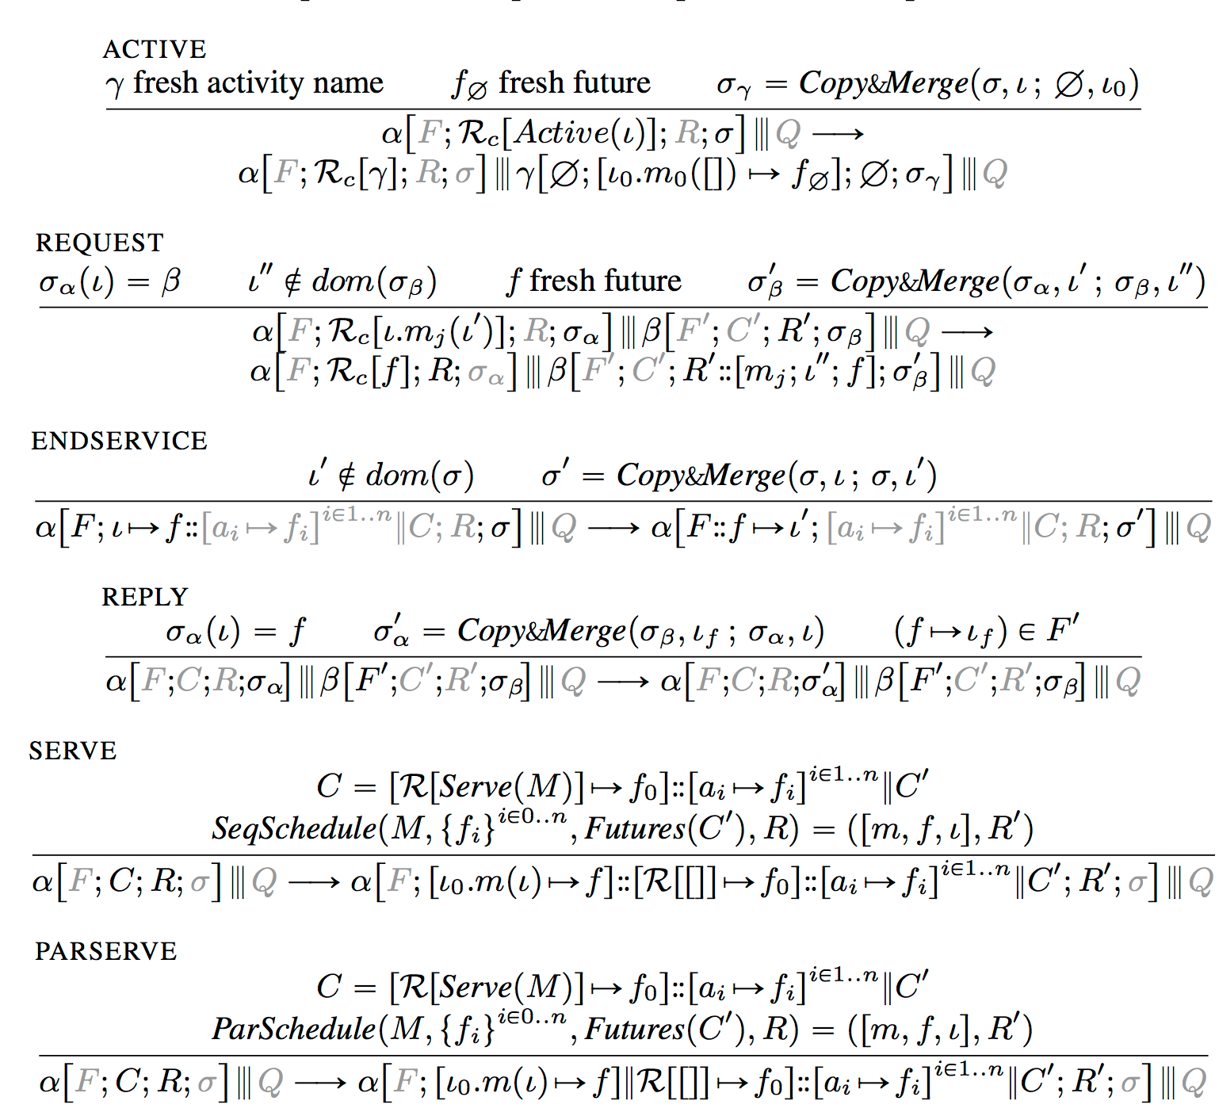

Slide 56
Active Objects
Asynchronous communication with futures
Location transparency
Composition:
An active object (1)
a request queue (2)
one service thread (3)
Some passive objects (local state) (4)
4
1
2
3
Notes:
Active objects
* coarse grained structuring entities of distributed apps.
* part of a design pattern to decouple method invocation from execution
* this is done by the help of asynch calls and futures
* thanks to futures, location is transparent
Internal structure
* request arrives into queue (invocation of method)
* executed one by one on the thread
* plain object is at base

